Slide 1



BLOOD DONATION MANAGEMENT
A PROJECT TO SPREAD GOOD DEEDS …
Rishi Jain, Pratik Kumar, Keshav Khanijho

Slide 2

Contents
Introduction
Problem Statement
Scope of Study
Features
System Requirements
Requirement analysis
Advantages & Disadvantages
Conclusion
References

Slide 3

INTRODUCTION
This project Is mainly towards persons who are willing to donate blood to the patients.
Through this system it will be easier to find a donor for exact blood type and easy to build the connection between donor and blood bank authorities.
The main intent of building this software is to formal the procedure of blood donation and motivate donors in order to donate blood.
We have tried to maintain all that information of donor which is easily understand to the doctors which makes them easy to find the donor.

Slide 4
ABSTRACT
The Main aim of the Blood Bank Management system is to ease the process of blood donation and allowance at the blood bank. We aim to demonstrate the use of creating, reading, updating, and deleting MySQL operations through this project. This project starts by adding details of the doctor. Once, registration is done doctor can add blood donor details with blood group, quantity, age, etc. Now, when the patient needs blood, doctors can easily check the blood group available and provide it to the blood receiver

Slide 5
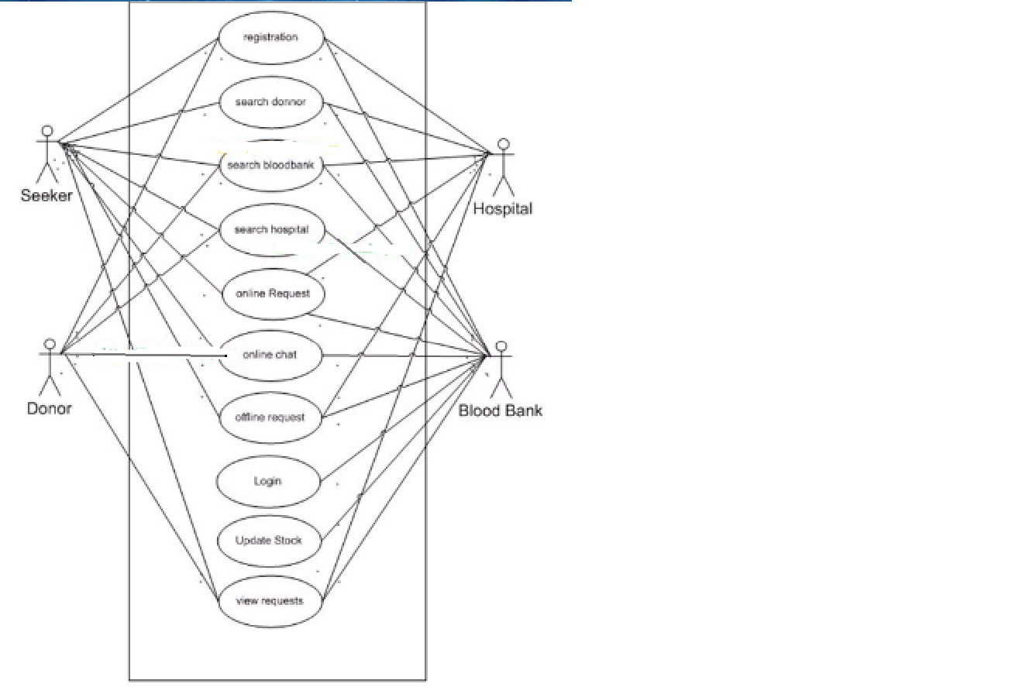
UML DIAGRAM

Slide 6
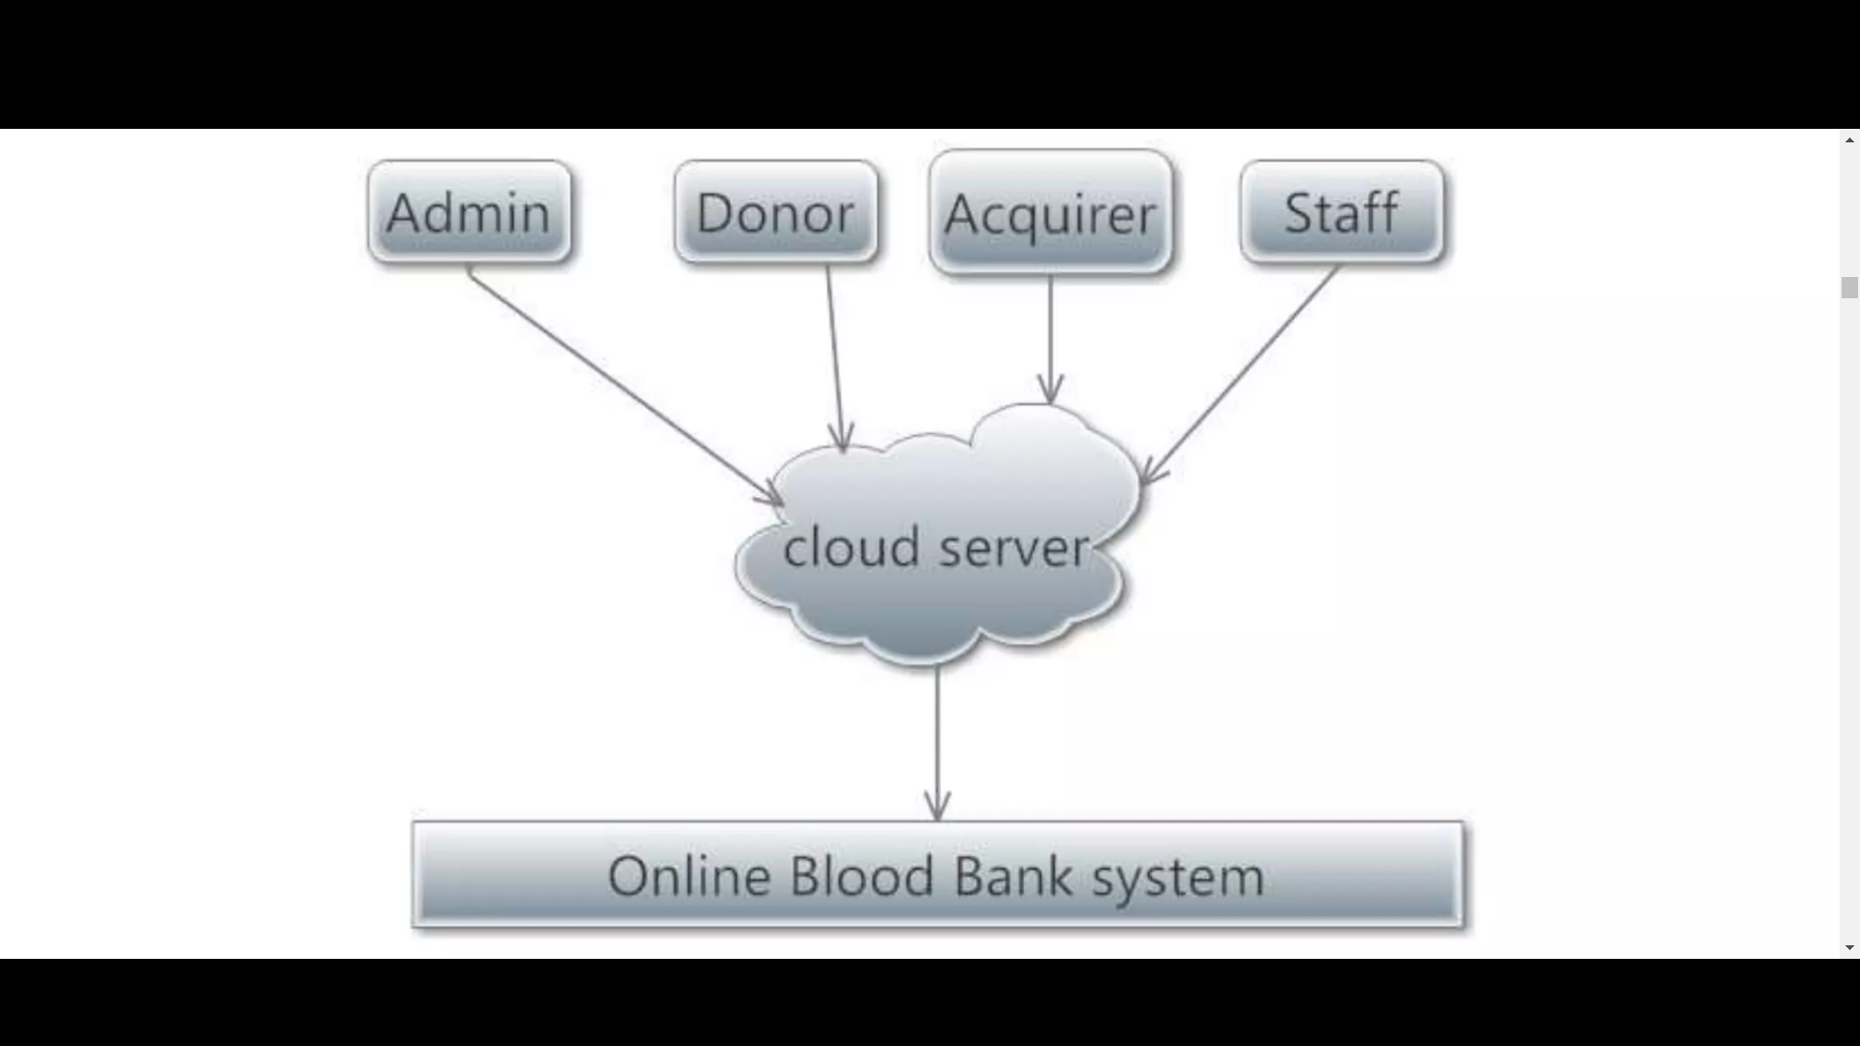
BLOCK DIAGRAM

Slide 7
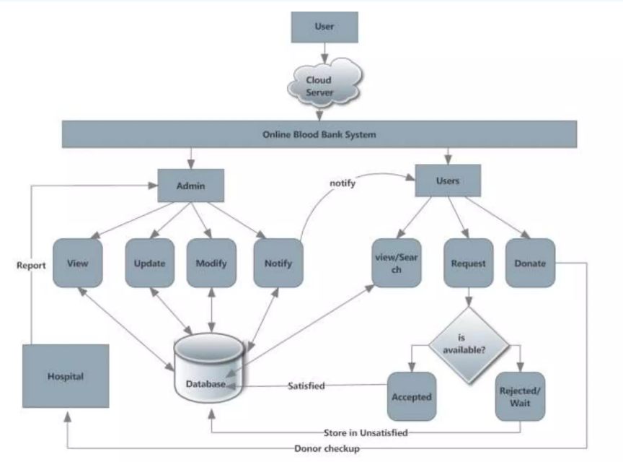
SYSTEM ARCHITECTURE DIAGRAM

Slide 8

Problem Statement
At present,the public can only know about the blood donation events through conventional media means such as radio, newspaper or television advertisements.
There is no information regarding the blood donation programs available on any of the portal
The current system that is used by the blood bank is a manual system. With the manual system, there are problems in managing the donor’s records.
The records of the donor might not be kept safely and there might be missing donor records due to human error or disasters.

Slide 9

Scope of Study
The system is used to maintain all the processes and activities of the blood bank management system.
The system can be extended to be used for maintaining records of hospitals, organ donation and other similar sectors. While developing the system, there shall be space for further modification.
There shall be proper documentation so that further enhancement becomes easy.
As a whole the system is focused to work with blood bank management system and on additional modification it can be also used as management systems of similar organizations.

Slide 10

Features
Login Page: The page where the system users will submit their system credentials to access the system data.
Home Page: The page where the system users will be redirected after logging into the blood bank management system. This page displays the available volume of each blood group and also displays the system data summary.
Donors Page: The page where can system admin user manages the list of system users.

Slide 11
Features
Blood Donation Page : The page where the donated blood is listed and managed. The system feature that updating the available volume of blood stocks.
Requests Page: The page where all the blood requests are listed and managed.
Handed Over Page: The page where all the given blood or handed over blood requests are listed and managed.
Users Page: The page where can system admin user manages the list of system users.

Slide 12

System Requirements
Hardware Requirement:
Hardware | Minimum Requirement | Reason
Processor | 1.6GHz | Accommodate most PCs
Memory of User PC | 512MB RAM | Relatively Fast
Disk Space of User PC | 5GB | Adequate Storage capacity
Memory of Server PC | 8GB | Fast
Bandwidth(network connection) | 15Mbps | Relatively Good
Disk space of Server | 200GB | Adequate storage for database and application

Slide 13
System Requirements
Software Requirement:
Software | Minimum Requirement | Reason
Operating System for Computer | Windows 7, Windows 8.1, Linux, Mac Os, Windows 8, Windows xp | Globally distributed and widely accessed
Database Management System | MySQL | Easy to use and scalable
Browser | Opera, Google, Chrome, IE, Mozilla Firefox | Standard browser

Slide 14


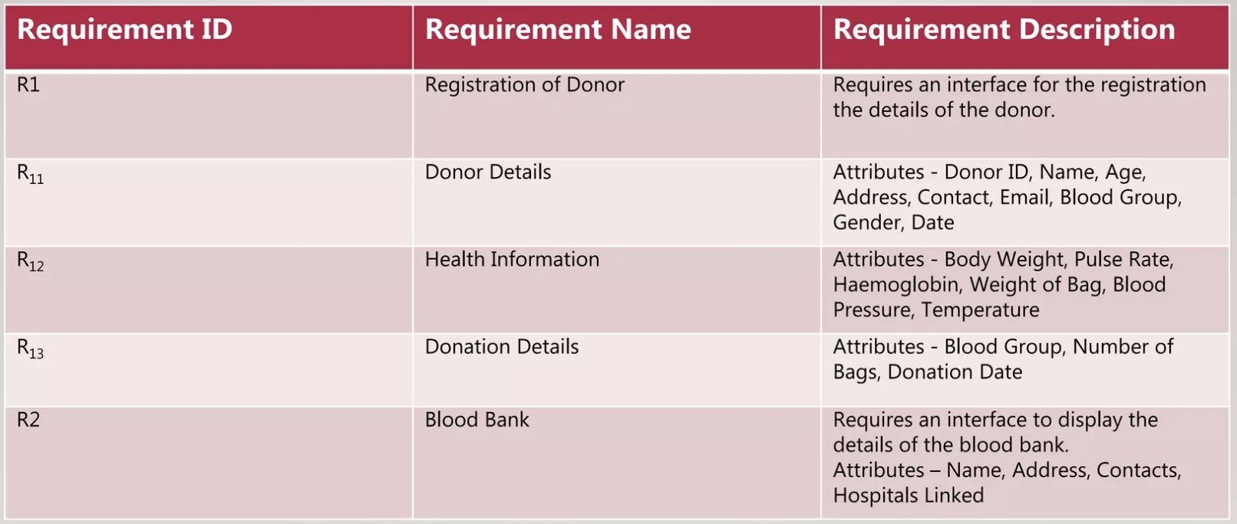
Requirement Analysis

Slide 15

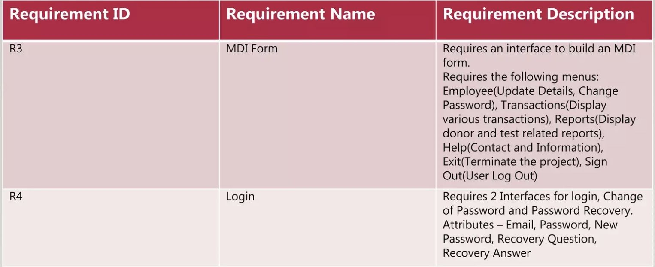
Requirement Analysis (cont.)

Slide 16
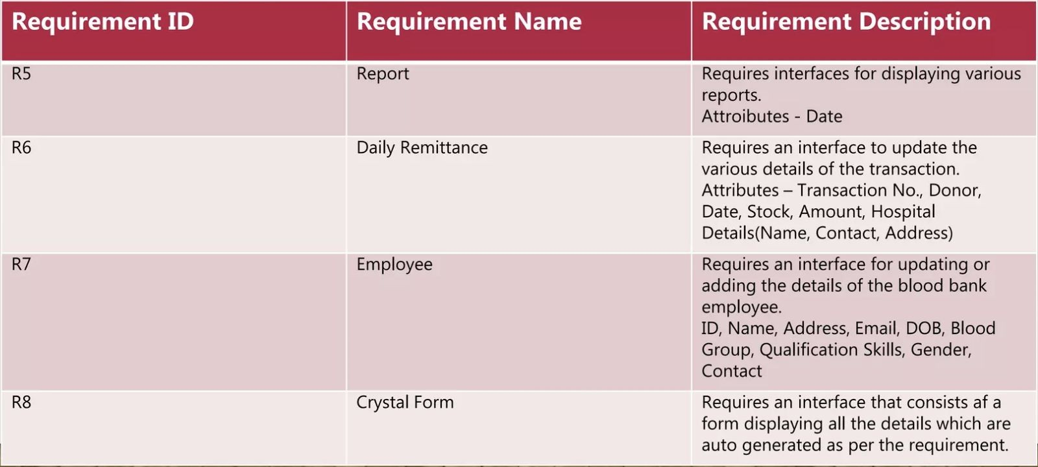
Requirement Analysis (cont.)

Slide 17

Advantages
Patients can access the availability of blood units in blood banks by using this website .
Minimizes the efforts of the patient to find a donor in time.
Alert mechanism for regular donors.
Helps both donor and patient to keep record of their health.
As the donor’s data is saved in the system we can reject those who have HIV or any other infections.
As we have the contact numbers of the donors we can contact whenever necessary comes.

Slide 18

Disadvantages
As it is a website so we cannot help donor to reach the patient.
Location is limited to a particular area.
Need internet to operate.

Slide 19
REFRENCES
https://www.slideshare.net/rohitjawale2/online-blood-bank-system-design
https://www.studocu.com/in/document/delhi-technological-university/database-management-systems/dbms-blood-bank-management-system/26578691
https://t4tutorials.com/use-cases-description-of-blood-bank-project/

Slide 20
THANK YOU

